Slide 1
Security

Slide 2
Security
Security
Information Security
Network Security
Computer Security
Internet Security

Slide 3
Information Security
Protecting Information from Intruders who could possibly harm the state of Information.
Information in encrypted form is most widely used form of security.

Slide 4
Network Security
Protecting Information from Intruders during its transmission.
Protecting Network Services From Intruders .
Very Critical and difficult to maintain.

Slide 5
Computer Security
Protecting system from malicious software, network attacks.
Generic name for the collection of tools designed to protect data and to prevent attacks.
Keep up a system running.

Slide 6
Internet Security
Measure to protect data during their transmission over a
collection of interconnected networks.

Slide 7
Security and Attacks
Security Attacks => Exploitation of vulnerability.
Any action that compromises the security of information
Types of Security attacks
Passive Attacks
Active attacks

Slide 8
Security Attacks

Slide 9
Security Attacks
Interruption: This is an attack on availability
Interception: This is an attack on confidentiality
Modification: This is an attack on integrity
Fabrication: This is an attack on authenticity

Slide 10
Passive Attacks
Learn or make use of Information from the system.
Doesn’t effect the system resource and Information
Doesn’t alter the system operation
Example:
Eavesdropping
Monitoring of Information

Slide 11
Passive Attacks Types
Two Types
Release of Message Contents
Traffic analysis

Slide 12
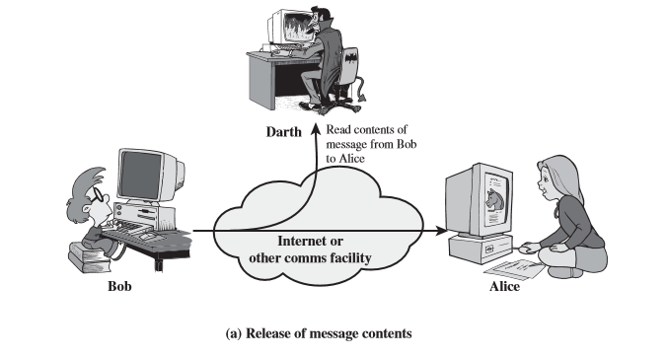
Release of Message Contents

Slide 13
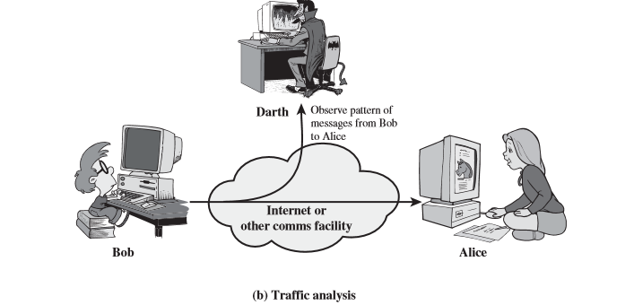
Traffic Analysis

Slide 14
Passive Attacks.
Difficult to detect are there is no alteration in Resource
Protection from Passive attacks
Encryption

Slide 15
Active attacks.
Modification of Data stream or creation of false stream
Four types
Masquerade
Replay
Denial of Service
Modification of message

Slide 16
Masquerade
One entity pretends to be different entity
Impersonating an entity that has those privileges by capturing the authentication sequence

Slide 17
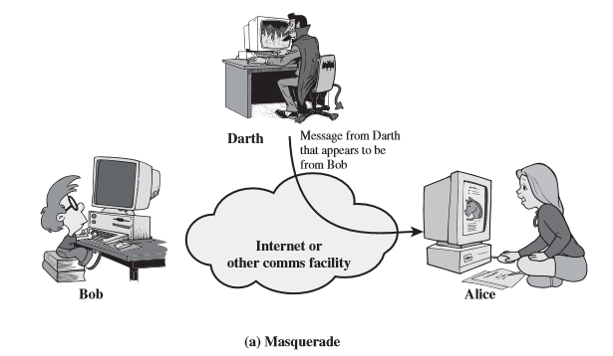
Masquerade

Slide 18
Replay
Involves the passive capture of a data unit and its subsequent retransmission to produce an unauthorized effect

Slide 19
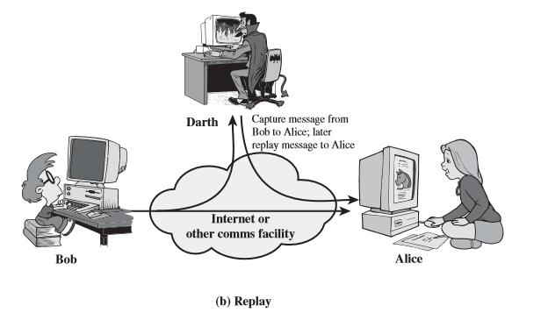
Replay

Slide 20
Modification of Message
Modifying some portion of legitimate message.
Message are delayed or altered.
“Allow John Smith to read confidential file accounts” is modified to mean “Allow Fred Brown to read confidential file accounts.”

Slide 21
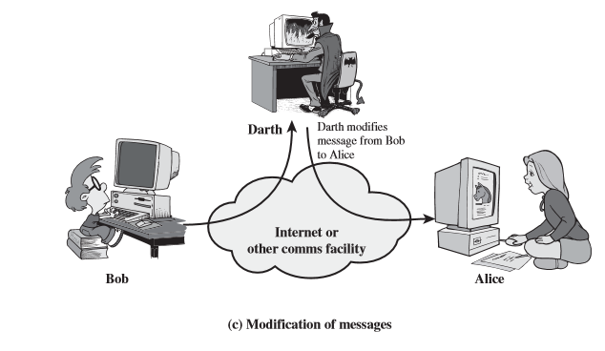
Modification of Message

Slide 22
Denial of services
Prevent the normal use or management of communication facilities.
It may have specific target.
Example:
Disruption of an entire network
By disabling the network
Overloading it with messages to degrade the performance

Slide 23
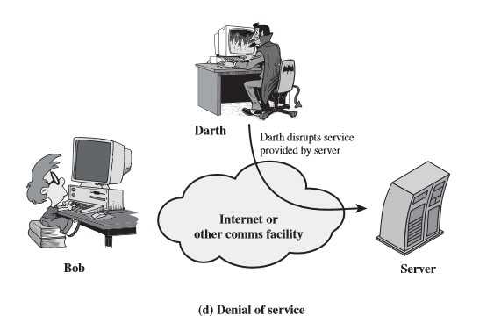
DOS

Slide 24
Active attacks Contd..
Opposite of Passive attacks.
Easy to detect but difficult to prevent.
variety of potential physical, software, and network vulnerabilities exist.

Slide 25
Security Services.
According X.800
Security Service is a service provided by the communicating protocol.
According RFC2828
A processing or communication service that is provided by a system to a system to give a specific kind of protection to system resources;

Slide 26
Five Categories of Security Services.
X.800 divides Security services in five categories.
Security services are implemented by Securities polices which are implemented by security mechanism.
Five Categories
Confidentiality
Integrity
Availability
Access Control
Non Repudiation

Slide 27
Security Services.
X.800 divides five categories in 14 specific services.

Slide 28
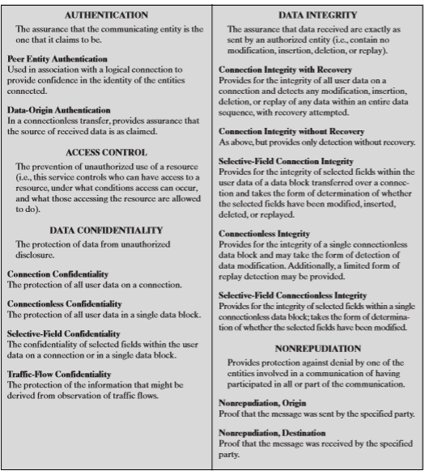

Slide 29
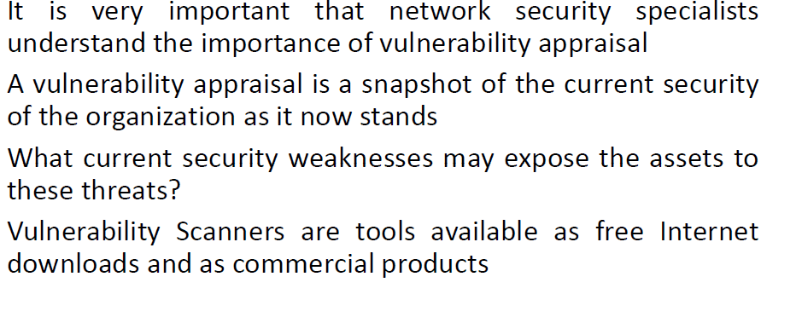
Vulnerability

Slide 30
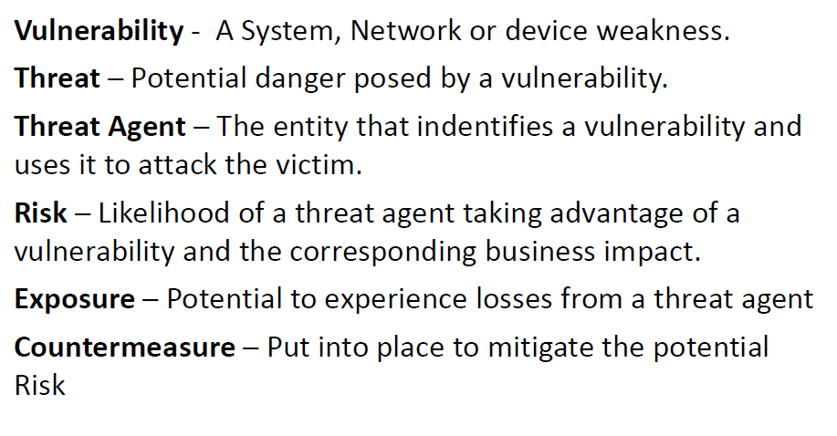
Risk Management Terms

Slide 31
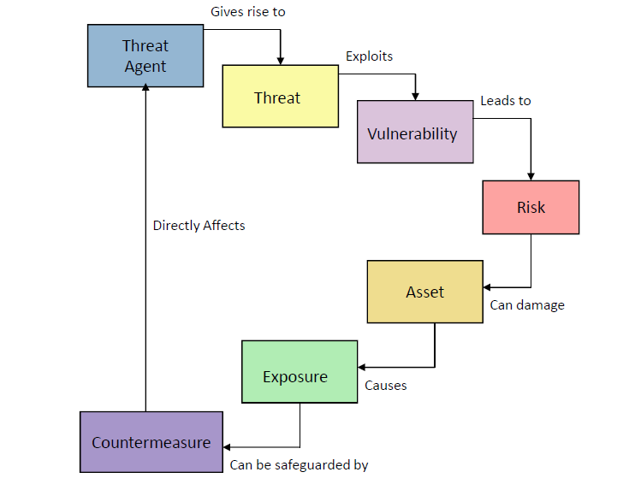
Understanding Risk

Slide 32
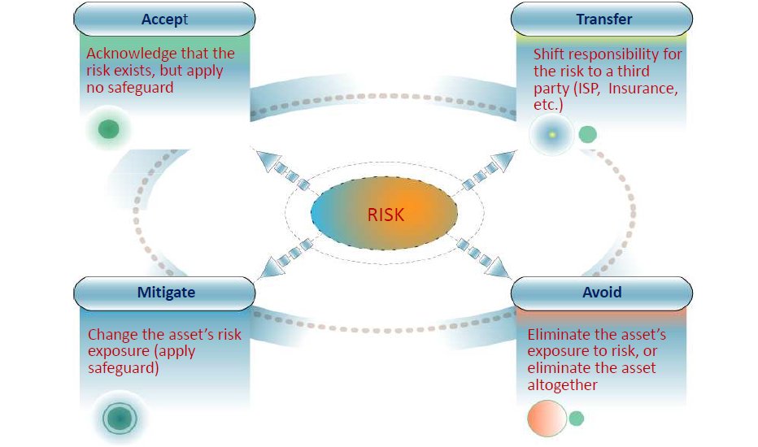
Managing Risk

Slide 33
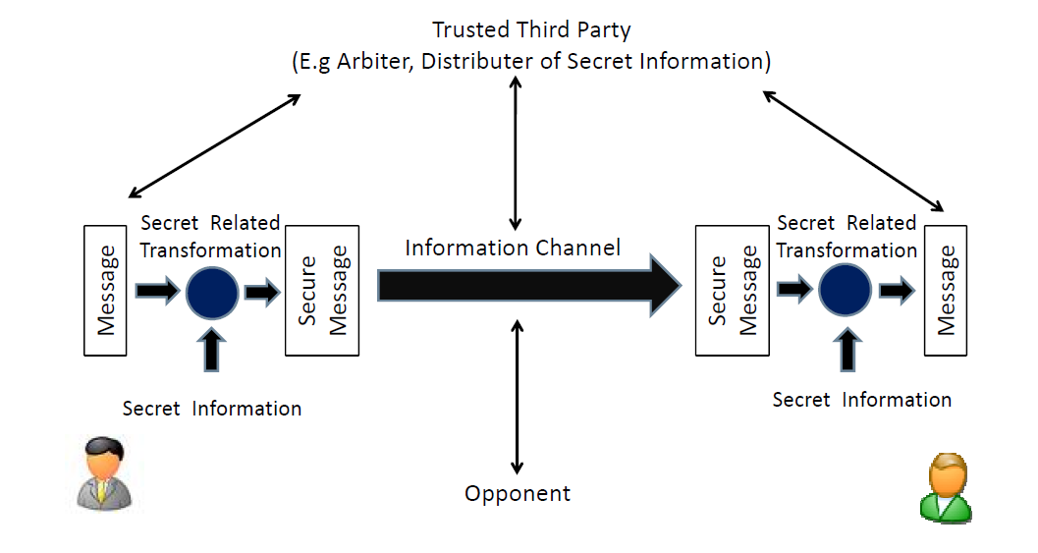
Network Security Model
Notes:
In considering the place of encryption, its useful to use the following two models from Stallings section 1.6.
The first, illustrated in Figure 1.4, models information being transferred from one party to another over an insecure communications channel, in the presence of possible opponents. The two parties, who are the principals in this transaction, must cooperate for the exchange to take place. They can use an appropriate security transform (encryption algorithm), with suitable keys, possibly negotiated using the presence of a trusted third party. Parts One through Four of this book concentrates on the types of security mechanisms and services that fit into the model shown here.

Slide 34
Model for Network Security
using this model requires us to:
design a suitable algorithm for the security transformation
generate the secret information (keys) used by the algorithm
develop methods to distribute and share the secret information
specify a protocol enabling the principals to use the transformation and secret information for a security service
Notes:
This general model shows that there are four basic tasks in designing a particular security service, as listed.

Slide 35
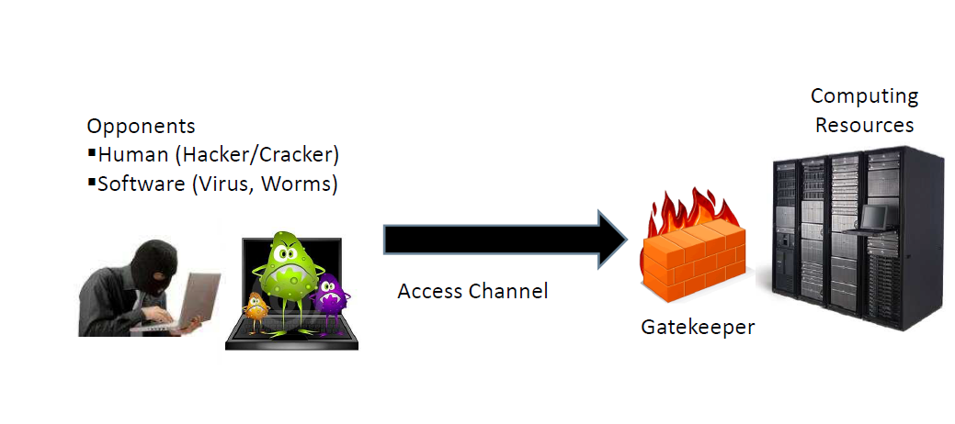
Network Security Access Model

Slide 36
Model for Network Access Security
using this model requires us to:
select appropriate gatekeeper functions to identify users
implement security controls to ensure only authorised users access designated information or resources
Notes:
Detail here the tasks needed to use this model.

Slide 37
Standards Organizations
National Institute of Standards & Technology (NIST)
Internet Society (ISOC)
International Telecommunication Union Telecommunication Standardization Sector (ITU-T)
International Organization for Standardization (ISO)
Notes:
Throughout this book, we describe the most important standards in use or being developed for various aspects of cryptography and
network security. Various organizations have been involved in the development or promotion of these standards including:
• NIST is a U.S. federal agency that deals with measurement science, standards, and technology related to U.S. government use
and to the promotion of U.S. private-sector innovation. Despite its national scope, NIST Federal Information Processing Standards (FIPS) and Special Publications (SP) have a worldwide impact.
• ISOC is a professional membership society with worldwide organizational and individual membership. It provides leadership in addressing issues that confront the future of the Internet and is the organization home for the groups responsible for Internet infrastructure standards, including the Internet Engineering Task Force (IETF) and the Internet Architecture Board (IAB). These organizations develop Internet standards and related specifications, all of which are published as Requests for Comments (RFCs).
• ITU is an international organization within the United Nations System in which governments and the private sector coordinate global telecom networks and services The ITU Telecommunication Standardization Sector (ITU-T) is one of the three sectors of the ITU. ITU-T's mission is the production of standards covering all fields of telecommunications. ITU-T standards are referred to as Recommendations.
• ISO is a worldwide federation of national standards bodies from more than 140 countries, one from each country. ISO is a nongovernmental organization that promotes the development of standardization and related activities with a view to facilitating the international exchange of goods and services, and to developing cooperation in the spheres of intellectual, scientific, technological, and economic activity. ISO's work results in international agreements that are published as International Standards.

Slide 38
Summary
topic roadmap & standards organizations
security concepts:
confidentiality, integrity, availability
X.800 security architecture
security attacks, services, mechanisms
models for network (access) security
Notes:
Chapter 1 summary.

